Slide 1
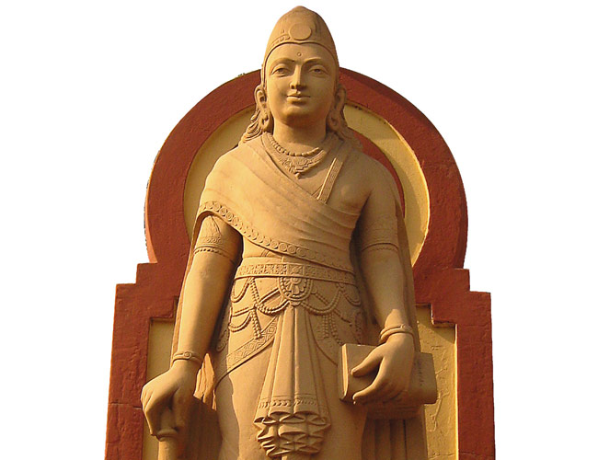
Chandragupta Maurya
Born around 340 B.C.E. in what is today Bihar
Defeated the king of Magadha and became king around 324 B.C.E.
Conquered the Nanda Empire in 322 B.C.E. and established the Mauryan Empire

Slide 2
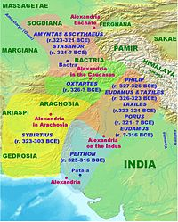
Expansion of the Empire
Expansion began in northwestern India in 323 B.C.E. after Alexander’s death
Launched an invasion of the Seleucid Empire in 305 B.C.E.
A peace treaty in 303 B.C.E. allowed the retention of conquered territories

Slide 3
Expansion of the Empire
Following peace with the Seleucid Empire the empire was expanded south into the Deccan Plateau
Chandragupta died in 297 B.C.E. and was succeeded by his son Bindusara who ruled until 272 B.C.E.
One of the greatest rulers was Ashoka the Great, son of Bindusara
Ashoka came to the Mauryan throne in 268 B.C.E. after a war over succession

Slide 4
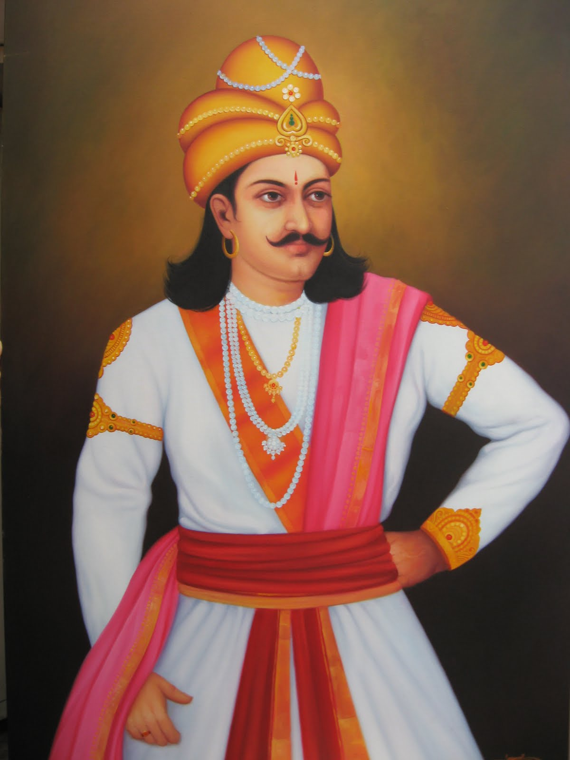
Ashoka the Great (304 – 232 B.C.E.)
Born in Pataliputra in 304 B.C.E
Received his military training early in life
Gained a reputation as a fearless warrior
Quelling of revolts in western provinces consolidated his power

Slide 5
Ashoka the Great
Became a Buddhist in 260 B.C.E. following the massive loss of lives during the Kalinga War
Promoted Buddhism within the empire
Promoted moral values
Appointed governors to oversee the provinces
Wanted to conquer by righteousness
Viewed as an enlightened ruler
Died in 232 B.C.E.

Slide 6
Mauryan Empire
Very centralized and efficient in civil and military organizations
Contact with the west encouraged cultural development throughout the empire
Developed an excellent road system
The arts, industry and education flourished throughout the empire
Empire was in decline until its overthrow in 185 B.C.E. by the Sunga

Slide 7
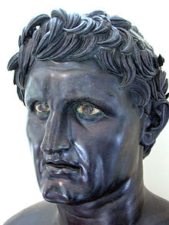
Seleucus I Nicator
Born to a noble family in Macedon in 358 B.C.E.
Served as a aide to Phillip II
Joined Alexander’s army in 334 B.C.E.
By 327 B.C.E. had risen to a major command position in the army

Slide 8
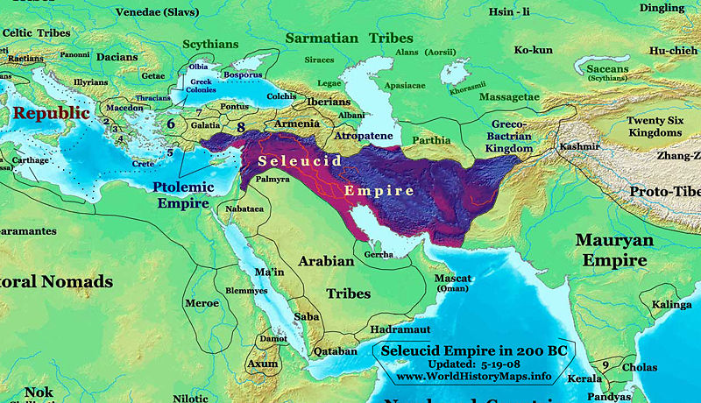
Seleucus I
Seleucus was given the Babylonian region in the partition of Alexander the Great’s empire in 320 B.C.E.
Involved in civil wars for control of Alexander’s empire
He soon began military campaigns to the east and west to expand his empire

Slide 9
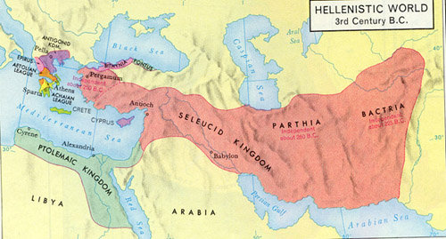
Seleucid Empire
Fought war with the Mauryan Empire from 305 – 303 B.C.E.
Defeated Antigonus I at the Battle of Ipsus in 301 B.C.E.
Empire reached its peak after gaining control over Anatolia in 281 B.C.E.

Slide 10
Decline of the Seleucid Empire
Seleucus I was assassinated in September 281 B.C.E. while planning an invasion of Macedon
Continued wars from 281 – 246 B.C.E. left the empire weak and fragmented
By 245 B.C.E. the provinces of Bactria and Parthia declared its independence
A series of wars with Egypt, known as the Syrian Wars, from 274 -168 B.C.E. led to a resurgence of the empire

Slide 11
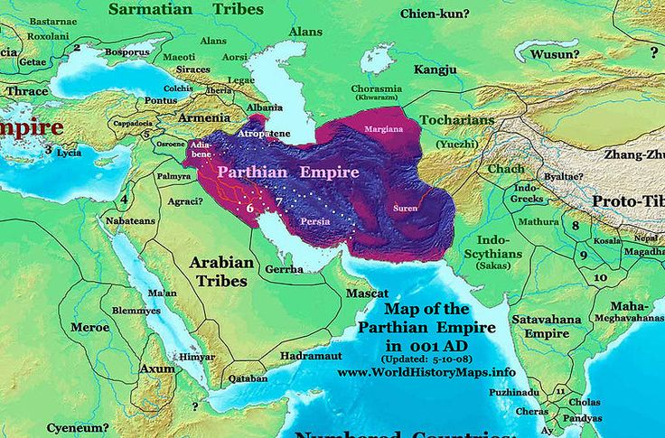
Decline of the Seleucid Empire
Defeated by the growing Roman Empire by 188 B.C.E.
By 100 B.C.E. the empire was reduced to control of just a few cities in Syria
Parthians defeated the Romans in 53 B.C.E. halting Roman incursions into the region
The Parthian Empire reached its peak between 53 B.C.E. – 233 C.E.

Slide 12
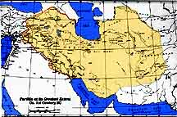
Parthian Empire
Parthia established as a kingdom in 247 B.C.E.
Mithradates I led the empire to its peak by his death in 138 B.C.E.
Parthian Empire influence increases after victory over Rome in 53 B.C.E.
Continued civil wars led to the collapse of the empire in 224 C.E.

Slide 13
Mithradates I
Born around 195 B.C.E.
Ruled Parthia from 165 – 132 B.C.E.
Expanded Parthian control to the east gaining control over portions of major trade routes
Conquered Babylonia in 144, Media in 141 and Persia in 139 B.C.E.
Promoted religious tolerance within his empire

Slide 14
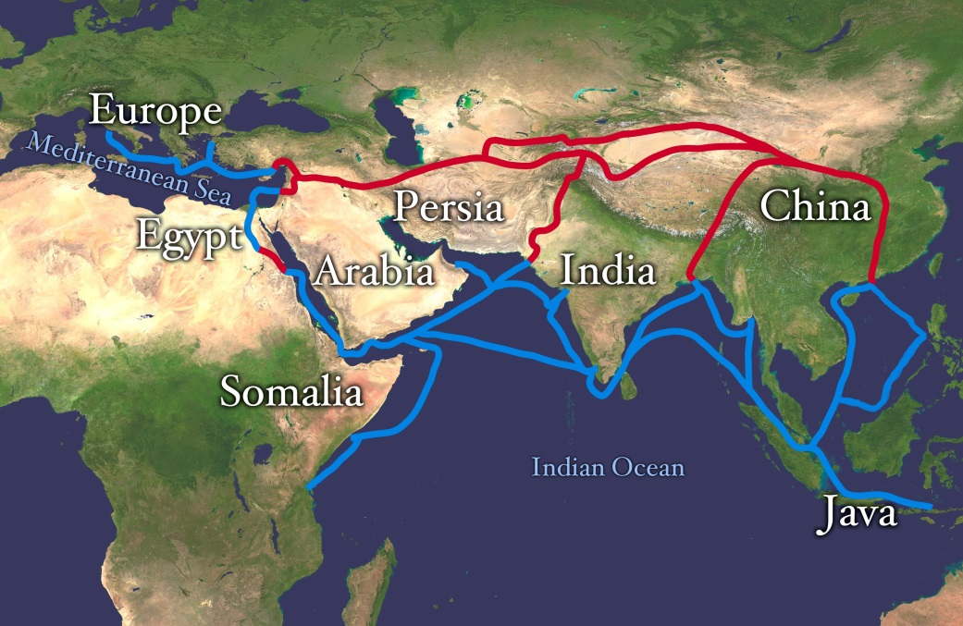
Trade Routes
By the 1st century B.C.E. trade routes extended from China westward
The overland routes became known as “the Silk Roads”
The long distance trade connected the peoples of many regions

Slide 15
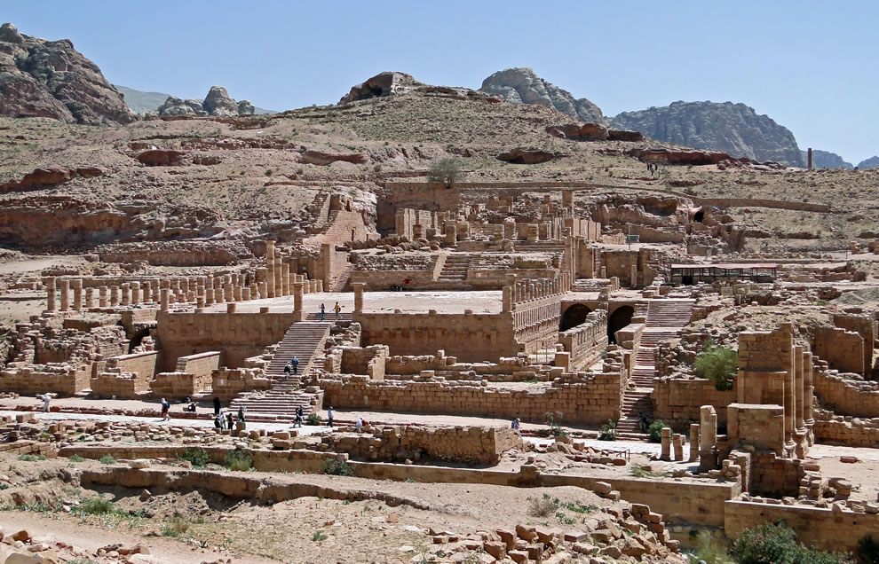
Petra
Established around 312 B.C.E. along major trade routes
Became a large caravan city trading silks, textiles and spices by 100 B.C.E.
Trade through the city declined after it was conquered by Rome in 106 C.E.

Slide 16
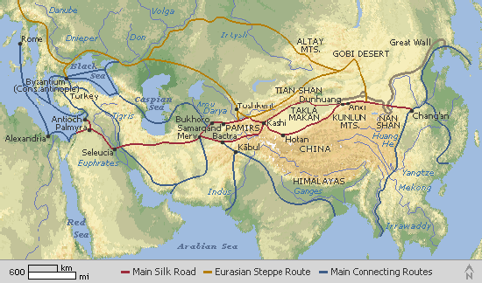
Trade and China
By 300 B.C.E. the Silk Roads linked east and west
Silk was valued by the ruling class and elites
Chinese farmers grew produce for sale at markets along trade routes
Led to the development of a coinage system

Slide 17
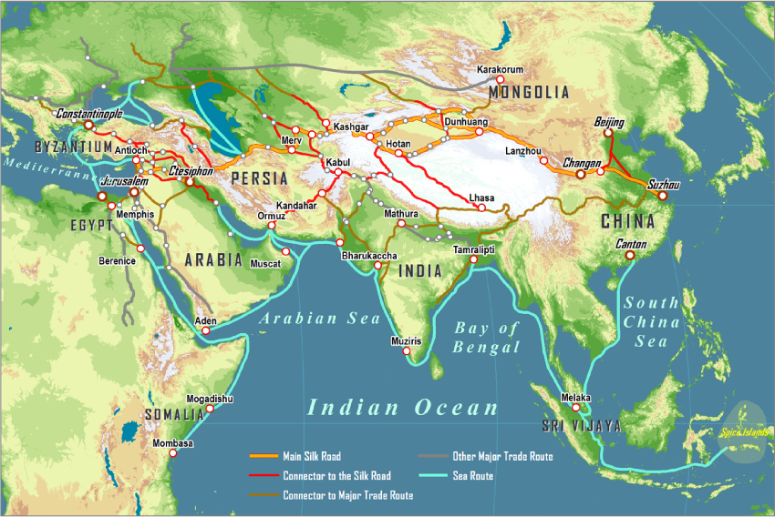
Sea Trade Routes
By 350 B.C.E. sea trade routes were expanding
Larger and faster ships carried more cargo
Viewed as a safer route for trading goods

Slide 18
Expanding Trade
By the 1st century B.C.E. Arab and Indian ships transported goods across the Indian Ocean
Alexandria, Egypt emerged as a leading center of trade
New navigational techniques and knowledge expanded sea trade routes
New seaport cities were established along the Indian Ocean for trade

